Slide 1
Software Engineering
(CSE-415)
Software Quality Assurance

Slide 2
Introduction
Software Quality Assurance (SQA) is an umbrella activity that is applied throughout the software process.
SQA encompasses-
A software quality assurance process
Specific quality assurance and quality control tasks ( including formal technical reviews and a multi-tier testing strategy)
Effective software engineering practice (methods and tools)
Control of all software work products and the changes made to them
A procedure to ensure compliance with software development standards
Measurement and reporting mechanisms

Slide 3
Quality Concepts
Software engineers strive to control the
  process applied
  resources expended
  end product quality attributes

Slide 4
What is Quality ?
Refers to measurable characteristics.
For software, two kinds of quality may be encountered:
  Quality of design: refers to characteristics that designers specify for the end product to be constructed. Quality of design encompasses requirements, specifications, and the design of the system.
  Quality of conformance: is the degree to which design
  specifications are followed during developing the product. Quality of conformance is an issue focused primarily on implementation.
Crucial is customer satisfaction (and quality is only a part of it):
  User satisfaction = compliant product + good quality + delivery within budget and schedule
At the bottom line ==> Quality is important, but if the user isn’t satisfied, nothing else really matters!

Slide 5
Quality Control (QC)
QC is defined as the processes and methods used to monitor work and observe whether requirements are met. It focuses on reviews and removal of defects before shipment of products.
QC involves series of inspections, reviews, and tests used throughout the software process to ensure each work product meets the requirements placed upon it.
QC includes a feedback loop to the process that created the work product.

Slide 6
Quality Control (QC)
A key concept of quality control is that all work products have defined, measurable specifications to which we may compare the output of each process. Feedback loop is essential to minimize the defects produced.
QC is the operational techniques and activities used to fulfill and verify requirements of quality.
Quality Control is a product-oriented activity.

Slide 7
Quality Assurance
QA consists of a set of auditing and reporting functions that assess the effectiveness, correctness, and completeness of QC activities.
The goal of QA is to provide management with the data necessary to be informed about product quality, thereby gaining insight and confidence that product quality is meeting its goals.

Slide 8
Quality Assurance
QA is the process of defining how software quality can be achieved and how the development organization knows that the software has the required level of quality.
QA is a planned and systematic pattern of all actions necessary to provide adequate confidence that an item or product conforms to established technical requirements.
QA is an effective approach for producing high quality product.
QA is a process-oriented activity and it is oriented to bug- prevention.

Slide 9
Cost of Quality
Quality costs may be divided into costs associated with prevention, appraisal, and failure
  1) Prevention costs include quality planning, formal technical reviews, test equipment, training.
  2) Appraisal costs include activities to gain insight into product condition
  3) Failure costs are those that would disappear if no defects appeared before shipping a product to customer.
      Internal
      External

Slide 10
Failure Costs
Failure Costs may be subdivided into two categories-
Internal failure costs are incurred when we detect a defect in our product prior to shipment.
  rework, repair, failure mode analysis
b) External failure costs are associated with defects found after the product has been shipped to the customer.
      complaint resolution, product return and replacement, help line support, warranty work

Slide 11
Cost of Correcting Defects
Relative costs to find and repair a defect increase dramatically:
  From prevention to detection
  From internal vs. external
IBM example:
  Prevention = ~$90/defect
  Field fix = ~$25,000/defect

Slide 12
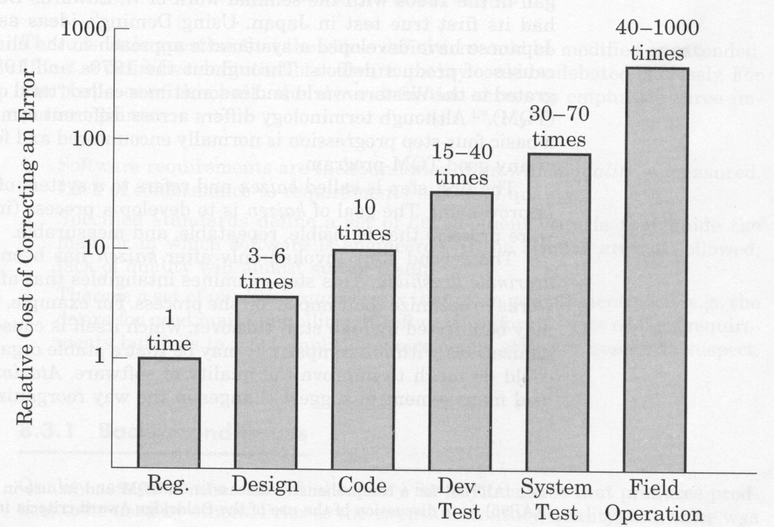
Relative cost of correcting an errors

Slide 13
Software Quality
Conformance to explicitly stated functional and performance requirements, explicitly documented development standards, and implicit characteristics that are expected of all professionally developed software.

Slide 14
Software Quality Assurance(SQA)
Software quality assurance [IEEE]:
A planned and systematic pattern of all actions necessary to provide adequate confidence that an item or product conforms to established technical requirements.
A set of activities designed to evaluate the process by which the products are developed or manufactured.

Slide 15
Software Quality Assurance(SQA)
Three important points for software quality:
Software requirements are the foundation from which quality is measured. Lack of conformance to requirements is lack of quality.
Specified standards define a set of development criteria that guide the manner in which software is engineered.
Software must conform to explicit requirements as well as its implicit requirements (ease of use, maintainability, reliability, etc.).

Slide 16
What is the role of an SQA group?
Prepare SQA plan for the project.
Participate in the development of the project's software process description.
Review software engineering activities to verify compliance with the defined software process.
Audit designated software work products to verify compliance with those defined as part of the software process.
Ensure that any deviations in software or work products are documented and handled according to a documented procedure.
Record any evidence of noncompliance and reports them to senior management.

Slide 17
Software Reviews
Software reviews are like “filters” in the software process workflow.
Software reviews are applied at various points during software engineering and serve to uncover errors and defects that can then be removed.
Software reviews “purify” the software engineering activities.

Slide 18
Software Reviews
Purpose is to find defects (errors) before they are passed on to another software engineering activity or released to the customer.
Software engineers (and others) conduct formal technical reviews (FTR) for software engineers.
Using formal technical reviews is an effective means for improving software quality.

Slide 19
What Are Reviews?
A meeting conducted by technical people for technical people
A technical assessment of a work product created during the software engineering process
A software quality assurance mechanism
A training ground

Slide 20
What Reviews Are Not …
A project summary or progress assessment
A meeting intended solely to impart information
A mechanism for political or personal reprisal!

Slide 21
Defect Amplification Models
Defect amplification models can be used to illustrate the generation and detection of errors during the preliminary design, detail design, and coding steps of a software engineering process.
They are simple mathematical models for describing how defects are propagated through the various steps in the software development process.

Slide 22
Formal Technical Review(FTR)
The primary objective of an FTR is to find errors before they are passed on to another software engineering activity or released to the end-user.
A formal technical review (FTR) is the most effective filter from a quality assurance standpoint.
Conducted by software engineers (and others) for software engineers, the FTR is an effective means for uncovering errors and improving software quality.

Slide 23
Formal Technical Review(FTR)
Objectives of Formal Technical Review (FTR):
To uncover errors in function, logic, or implementation
To verify that the software under review meets its requirements
To ensure that the software has been represented according to predefined standards
To achieve software that is developed in a uniform manner
To make projects more manageable

Slide 24
Formal Technical Review: The Roles
Presenter (designer/producer)
Coordinator (not a person who hires/fires)
Recorder
  records events of meeting
  builds paper trail
Reviewers
  maintenance person
  standards bearer
  User/customer representative or, play the role of user/customer
  designers etc.

Slide 25
Formal Technical Reviews-1
Typically involves 3 to 5 people (including reviewers)
Advance preparation (no more than 2 hours per person) required
Duration of review meeting should be less than 2 hours
Focus of review is on a discrete work product
Review leader organizes the review meeting at the producer's request.

Slide 26
Formal Technical Reviews - 2
Reviewers ask questions that enable the producer to discover his or her own error (the product is under review, not the producer)
Producer of the work product walks the reviewers through the product
Recorder writes down any significant issues raised during the review
Reviewers decide to accept or reject the work product and whether to require additional reviews of product or not.

Slide 27
Why do we conduct reviews?
To improve quality.
Catches 80% of all errors if done properly.
Catches both coding errors and design errors.
Enforce the spirit of any organization standards.

Slide 28
Formality and Timing
Formal review presentations
  resemble conference presentations.
Informal presentations
  less detailed, but equally correct.
Early
  tend to be informal
  may not have enough information
Later
  tend to be more formal
  Feedback may come too late to avoid rework

Slide 29
Formality and Timing
Analysis is complete
Design is complete
After first compilation
After first test run
After all test runs
Any time you complete an activity that produce a complete work product

Slide 30
Review Guidelines
Keep it short (< 1 hour).
Don’t schedule two in a row.
Don’t review product fragments.
Use standards to avoid style disagreements.
Let the coordinator run the meeting and maintain order.

Slide 31
Formal Approaches to SQA
Proof of correctness
Statistical SQA
Cleanroom process combines items 1 & 2.

Slide 32
Statistical Software Quality Assurance
Statistical Software Quality Assurance helps to improve the quality of the product and software process itself.
Steps to perform Statistical SQA:
  Information about software defects is collected and categorized
  Each defect is traced back to its underlying cause
  Using the Pareto principle (80% of the defects can be traced to 20% of all possible causes), isolate the "vital few" defect causes
  Move to correct the problems that caused the defects

Slide 33
Six Sigma for Software Engineering
Six Sigma is the most widely used strategy for statistical quality assurance in industry.
The term “six sigma” is derived from six standard deviations—3.4 instances (defects) per million occurrences—implying an extremely high quality standard.
The Six Sigma methodology defines three core steps:
  Define customer requirements and deliverables and project goals via well-defined methods of customer communication
  Measure the existing process and its output to determine current quality performance (collect defect metrics)
  Analyze defect metrics and determine the vital few causes.

Slide 34
Six Sigma for Software Engineering
Six Sigma suggests two additional steps to improve an existing software process:
  Improve the process by eliminating the root causes of defects.
  Control the process to ensure that future work does not reintroduce the causes of defects.

Slide 35
Software Reliability
Software reliability is defined as “the probability of failure-free operation of a computer program in a specified environment for a specified time”
Can be measured directly and estimated using historical and developmental data (unlike many other software quality factors)
Software reliability problems can almost always be traced back to defects in design or implementation.

Slide 36
Reliability Metrics
Measures of Reliability:
A simple measure of reliability is mean-time-between-failure (MTBF), where
    MTBF = MTTF + MTTR
    MTTF = mean time to failure
    MTTR = mean time to repair
Software Availability is the probability that a program is operating according to requirements at a given point in time and is defined as :
Availability = [MTTF/ (MTTF+MTTR)] x 100%
Reliability = MTTF/ (1 + MTTF) X 100%

Slide 37
Software Safety
Safety may be defined as "freedom from those conditions that can cause death, injury, occupational ill-ness, or damage to or loss of equipment or property." But safety is a relative concept. Nothing is absolutely safe under all conditions.
Software safety issues become important when computers are used to control real-time, safety-critical processes.
Software safety is a SQA activity that focuses on identification and assessment of potential hazards that may affect software negatively and cause an entire system to fail.
Early identification of software hazards allows developers to specify design features that can eliminate or at least control the impact of potential hazards.

Slide 38
Software Reliability vs. Software Safety
Both are closely related to each other.
Subtle difference:
  Software reliability uses statistical analysis to determine the likelihood that a software failure will occur without regard to consequences of failures.
  Software safety examines the ways in which failures result in conditions that can lead to mishap.

Slide 39
Quality Standards
ISO-9126 Quality Framework:
    The most influential one in the software engineering community today.
    Provides a hierarchical framework for quality definition, organized into quality characteristics and sub-characteristics
    Six top-level quality characteristics, each associated with its own exclusive(non-overlapping) sub-characteristics

Slide 40
Quality Standards
ISO-9126 quality characteristics:
  Functionality
  Reliability
  Usability
  Efficiency
  Maintainability
  Portability

Slide 41
Other Quality Frameworks
Adaptation of ISO-9126:
  Customized for companies
      e.g. IBM’s CUPRIMDSO( Capability, Usability, Performance, Reliability, Installation, Maintenance, Documentation, Service, Overall customer satisfaction)
  Adapted to application domains
      Reliability, usability, security for Web
Other quality frameworks/mega-models
  SEI/CMMI: process focus/levels
  McCall: factors, criteria
  Basili: GQM (goal-question-metric)
  Dromey: component reflects Q-attributes

Slide 42
SQA Plan
The SQA Plan provides a road map for instituting software quality assurance. Developed by the SQA group, the plan serves as a template for SQA activities that are instituted for each software project.
Management section
  describes the place of SQA in the structure of the organization
Documentation section
  describes each work product produced as part of the software process
Standards, practices, and conventions section
  lists all applicable standards/practices applied during the software process and any metrics to be collected as part of the software engineering work

Slide 43
SQA Plan
Reviews and audits section
  provides an overview of the approach used in the reviews and audits to be conducted during the project
Test section
  references the test plan and procedure document and defines test record keeping requirements
Problem reporting and corrective action section
  defines procedures for reporting, tracking, and resolving errors or defects, identifies organizational responsibilities for these activities
Other
  tools, SQA methods, change control, record keeping, training, and risk management

